Slide 1




EFFICIENT DYNAMIC PROOF OF RETRIEVABILITY FOR COLD STORAGE
Tung Le, Pengzhi Huang, Attila A. Yavuz, Elaine Shi, Thang Hoang
NDSS 2023
San Diego, California
Notes:
Hello everyone, now I’m going present our paper “Efficient Dynamic Proof of Retrievability for Cold Storage”.
I’m Tung Le. This is the joint work with Huang, Yavuz, Shi, and Hoang.

Slide 2








Overview
Storage-as-a service (STaaS)
Notes:
Nowadays, Storage-as-a-Service has become more and more ubiquitous. $↓$
It can provide a sophisticated data storage facility and infrastructure for clients to outsource their data to the cloud.
This can reduce expensive data management, maintenance, and archival costs.

Slide 3





Overview
Baseline | Static PoR (CCS’ 09)
Use HMAC to verify the integrity of data. Fast update, slow audit. | Insert “sentinels”. No update support. Limited audit times.
Notes:
However, cloud storage also brings significant concerns regarding data integrity to the client.
Data loss can happen due to unwanted accidents such as hardware failures or adversarial behaviors. $↓$
For instance, the adversary may delete certain parts of data $↓$ that are rarely accessed to reduce storage overhead and monetary costs. $↓$
$↓$ As a baseline design, the client can compute HMAC for her data and enclose HMAC with data on the cloud.
Later, the client can download her data, and verify it with HMAC to check the integrity of outsourced data.
However, this incurs a lot of overhead to check for a large database.
Proof of Retrievability (PoR), proposed by Juels and Kaliski in 2007, enables a client to store data blocks with a cloud server so that later the server can prove the possession of all the data in a very efficient manner.
(i.e., with constant computation and bandwidth).
Its mechanism is to insert sentinels into random positions in the database. For each audit request later, a portion of the inserted sentinels are used to verify.
This first PoR design is static, which means it doesn’t support update.
In addition, the number of audit times is limited.

Slide 4





Our Efficient PoR Technique
Audit Request
Audit Proof
Dynamic PoR (DPoR) allows efficient update ability.
Previous DPoRs | Our Work (Porla)
Low storage (USENIX’ 21) Fast update (CCS’ 13) Metadata privacy (JoC’ 17) | Small Proof Size Low Audit Time
Notes:
Proof of Retrievability works as follows. First, the client sends an audit request to the cloud server. $↓$
Then, the server returns an audit proof to the client. $↓$
By verifying this proof, the client can ensure that her outsourced data is still kept intact.
$$↓$$
To support both update and audit, Dynamic PoR schemes have been proposed. $↓$
Previous works focus on designing DPoRs that achieve low storage, fast update and metadata privacy.
Our DPoR design, which is called Porla, aim to achieve small proof size and low audit time.

Slide 5
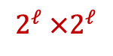
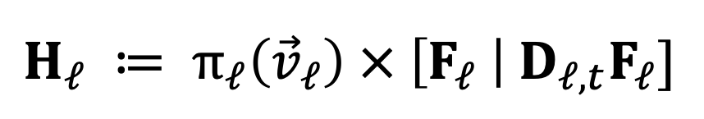
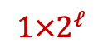
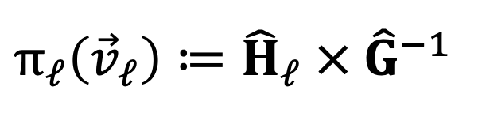
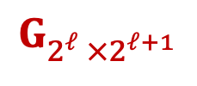
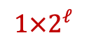

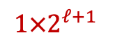
Error Correction Code
Error Correction Code allows recovering the entire dataset while tolerating a certain portion of damaged codewords.
github.com/vt-asaplab/porla/ICC
$$G_{2^{ℓ} ×2^{ℓ+1}}$$
$$1×2^{ℓ+1}$$
$$1×2^{ℓ}$$
$$H_{ℓ} ≔ π_{ℓ}\left({\vec{v}}_{ℓ}\right) × \left[F_{ℓ} \right| D_{ℓ, t}F_{ℓ}]$$
Any submatrix $2^{ℓ}×2^{ℓ}$of $G$ is non-singular
$π_{ℓ}\left({\vec{v}}_{ℓ}\right)≔{\hat{H}}_{ℓ} × {\hat{G}}^{−1}$
$$1×2^{ℓ}$$
$$2^{ℓ} ×2^{ℓ}$$
Notes:
Now, I’m going to talk about our Porla design.
Based on the previous work by Shi et. al. in 2013, our Porla also performs encoding data by a type of error correction code. $↓$
Basically, error correction code allows recovering the entire dataset while tolerating a certain portion of damaged codewords.
The error correction code that we use can allow up to half of codewords to be corrupted. $↓$
The codeword is computed as the formula here. A permuted data vector multiplies with a matrix G. $↓↓$
The output codeword H here will be double longer than the original data.
So, because any square sub-matrix of G is non-singular, we can compute the inversion of the submatrix of G $↓$ and multiply it with a subset of codewords H, denoted as H hat here to recover the original data.
For more details, please refer to our paper $↓$. We also have MATLAB example code here to exemplify how to build this error correction code and how to use it to recover data.

Slide 6
Incrementally Constructible Code (ICC)
Raw data buffer U.
Erasure code C: ECC built from U.
Hierarchical log H: Incrementally Constructible Code (ICC).
…
H₃
Codeword
H₂
Temporary Codeword
H₁
H₀
Notes:
The database that our Porla stores includes three components:
- Raw data buffer U
Erasure code C is error correction code computed from raw data buffer U.
Hierarchical log H is incrementally constructible code, where level l contains the codewords of 2^l newest updated data blocks.
For example, an updated data block will be written to H_0 $↓$, and after another new block $↓$, H_0 will be cleared and H_1 will be rebuilt $↓$.
And continue, after the next 2 new blocks, H_0 and H_1 will be cleared and H_2 will be rebuilt $↓↓↓↓$.

Slide 7

Incrementally Constructible Code (ICC)
Level $H_{ℓ}$ is rebuilt after every $2^{ℓ}$ updates.
After all $N$ blocks are updated, C is rebuilt.
…
H₃
Codeword
H₂
Temporary Codeword
H₁
H₀
ICC operations are based on FFT butterfly circuit.
Notes:
Similarly, for the next level H_3 $↓↓ ↓↓ ↓↓ ↓↓$.
$$↓$$
So, level H_l is rebuilt after every 2^l updates happen.
And after N updates, where N is the total number of data blocks in the database, erasure code C is rebuilt, and codewords in H at every level will be cleared.
In terms of amortized cost, each update just requires a computational complexity of O(log N), where N is the total number of data blocks.
And ICC operations are based on FFT butterfly circuit.

Slide 8
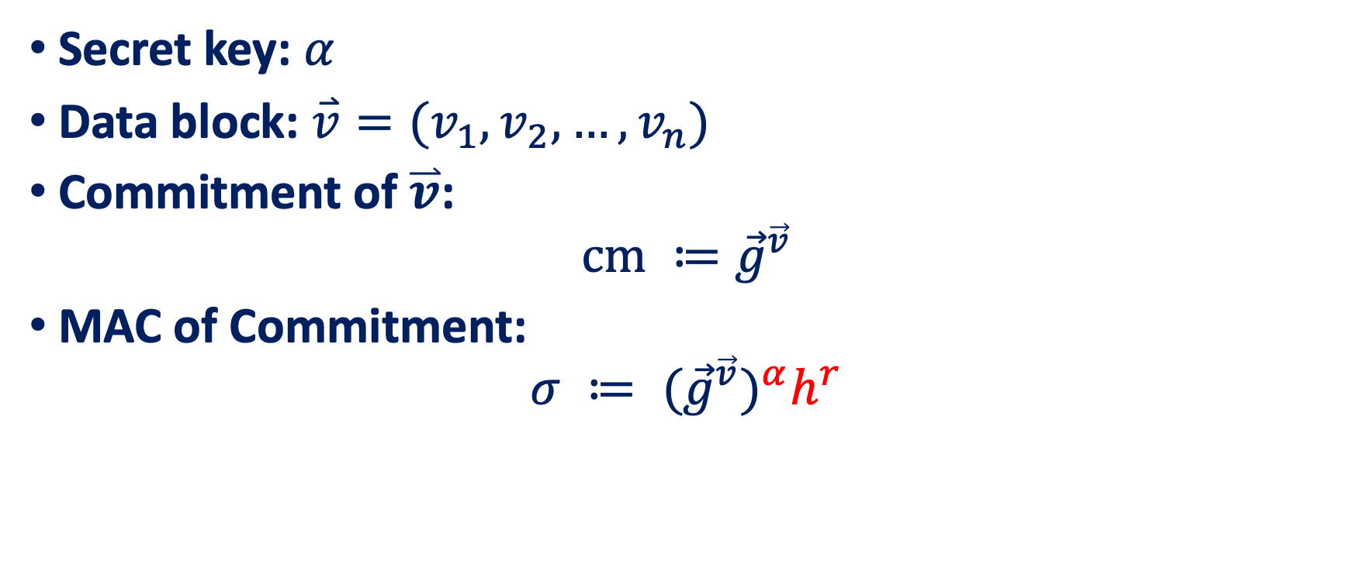
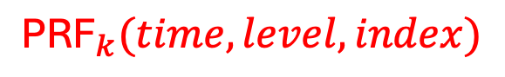

Homomorphic Authenticated Commitment
Secret key: $α$
Data block: $\overset{⃑}{v}=(v_{1}, v_{2}, …, v_{n})$
Commitment of $\overset{⃑}{v}$:
$$cm ≔{\vec{g}}^{\vec{v}}$$
MAC of Commitment:
$$σ ≔ {({\vec{g}}^{\vec{v}})}^{α}h^{r}$$
$$\vec{g}∈𝔾^{n}$$
$${\text{PRF}}_{k}(time, level, index)$$
$$h∈𝔾$$
MAC
Notes:
I am going to introduce several definitions and notations in our work here.
$↓$ We use alpha to denote a secret key.
$↓$ A data block v is written as a vector of values.
$↓$ The commitment of a data block v is cm, with g is a vector of group elements.
$↓$ And MAC of Commitment $↓$, sigma, which is computed with secret key alpha, and another component h^r, with h here is a group element.
$↓$ And r is the output from a pseudorandom function with another secret key k.
This MAC has the important property that it is additively homomorphic, which means we can compute the MAC of a linear combination of data blocks from the MAC of separate components.
You can have a look at our paper to see the proof of its homomorphism.

Slide 9

Data Structures
Raw buffer U:
…
Erasure code C:
…
Hierarchical Log H:
…
H₃
Data block
H₂
Codeword
H₁
Homomorphic MAC
H₀
Notes:
As described previously, our data structure includes:
$↓$ A raw buffer U, which is integrated with Merkle Tree. The client keeps track of the root of the Merkle Tree to verify the integrity of data when reading from buffer U.
$↓$ Erasure code C is computed from raw data buffer U.
$↓$ And hierarchical log H.
Each codeword block in erasure code C and H is enclosed with a homomorphic MAC.

Slide 10
Update Procedure
Kept by the client
R
Raw buffer U:
…
…
…
…
Merkle Tree
L
L
L
L
L
L
L
L
…
Hierarchical Log H:
HMAC
…
Data block
H₁
H₀
Codeword
Homomorphic MAC
Erasure code C: computed from U after $N$ updates happen.
Notes:
To update a data block $↓$, the client writes it to the raw buffer U. $↓↓$
In addition, the client also needs to update HMAC values on the Merkle path corresponding to the updated data block. $↓$
The root of the Merkle tree is kept by the client to check the integrity of data when reading from this raw buffer later.
$$↓$$
The client also sends a MAC tag of the updated data block. The server uses the data block and this tag to perform updating hierarchical log H.
When rebuilding a level in the hierarchical log, the server receives complementary values from the client to update MAC tags at the new level.
$$↓$$
And after N updates, where N is the total number of data blocks, erasure code C is rebuilt from raw buffer U.

Slide 11
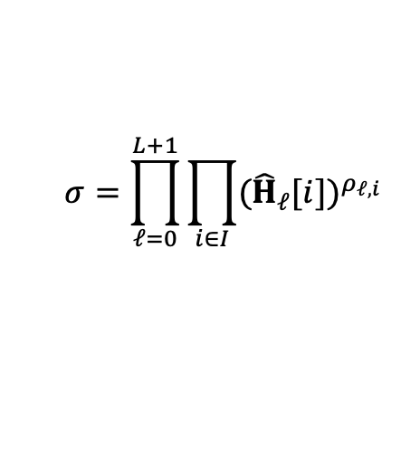
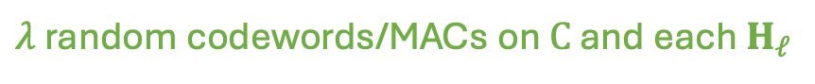
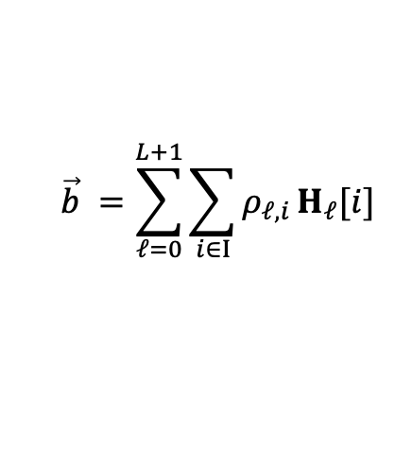
Audit Procedure
Erasure code C:
…
Hierarchical Log H:
…
H₃
H₂
Codeword
H₁
Homomorphic MAC
$$\vec{b} =\sum_{ℓ=0}^{L+1}{\sum_{i∈Ι}{ρ_{ℓ,i}}H_{ℓ}[i]}$$
$$σ=\prod_{ℓ=0}^{L+1}{\prod_{i∈I}{{{(\hat{H}}_{ℓ}[i])}^{ρ_{ℓ,i}}}}$$
H₀
random scalars indicated by the client
$λ$ random codewords/MACs on $C$ and each $H_{ℓ}$
A random linear combination
Notes:
Our Audit Procedure works as follows. $↓$
In erasure code C and each level of hierarchical log H, we choose lambda random codewords and their MAC of commitments.
Then, we compute the aggregated codeword b and its MAC value sigma as the formulas shown here. $↓$
Rho_l, i here are random scalars indicated by the client. These scalar values can be generated from a random seed value.
We can consider this as a random linear combination of codewords and their homomorphic MACs.

Slide 12

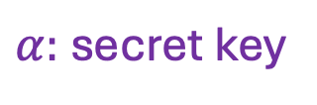
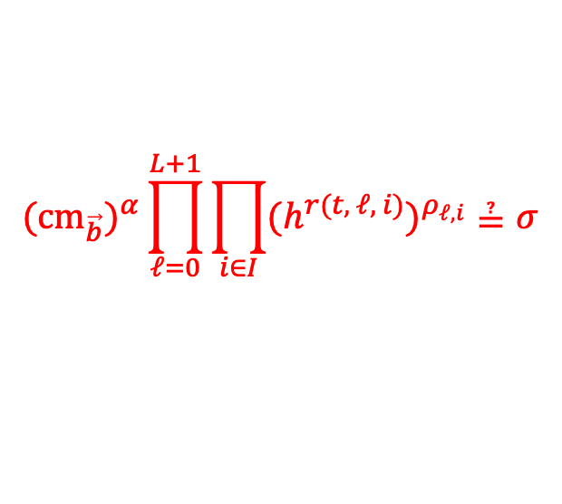
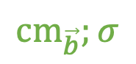
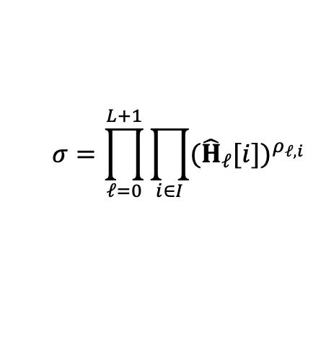
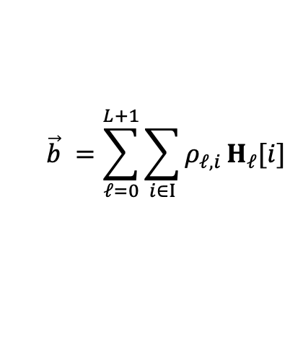
Our Audit Protocol
$$\vec{b} =\sum_{ℓ=0}^{L+1}{\sum_{i∈Ι}{ρ_{ℓ,i}}H_{ℓ}[i]}$$
$$σ=\prod_{ℓ=0}^{L+1}{\prod_{i∈I}{{{(\hat{H}}_{ℓ}[i])}^{ρ_{ℓ,i}}}}$$
$α:$ secret key
Audit request + a random seed
Commitment & MAC of
aggregated codeword block
$${{(cm}_{\vec{b}})}^{α}\prod_{ℓ=0}^{L+1}{\prod_{i∈I}{{{(h}^{r(t, ℓ, i)})}^{ρ_{ℓ,i}}}}≟σ$$
$${cm}_{\vec{b}};σ$$
Notes:
So our audit protocol. Suppose that a user stores his database on a cloud and he would like to perform an audit. $↓$
The client starts by sending an audit request and a random seed to the server. $↓$
Then, the server returns back to the client the commitment and MAC of the aggregated codeword block. $↓$
The client with secret key alpha $↓$ can compute the MAC from the commitment of the aggregated codeword, and compare it with the aggregated MAC that he receives from the server.
If they are equal, it means the commitments of codeword blocks are correct.

Slide 13
Not Enough!
Erasure code C:
…
Hierarchical Log H:
…
H₃
Codeword
H₂
Homomorphic MAC
H₁
H₀
Commitment
Notes:
However, the server can compute the commitments of codeword blocks and just store the commitments and MAC values of codeword blocks. $↓$ $↓$
Codeword blocks can still be deleted from the server and the audit protocol is still passed.
Therefore, audit proof created by using only Commitment and MAC of the aggregated codeword block is insufficient.
The server needs to provide a proof of its knowledge about the aggregated codeword block for the client.

Slide 14

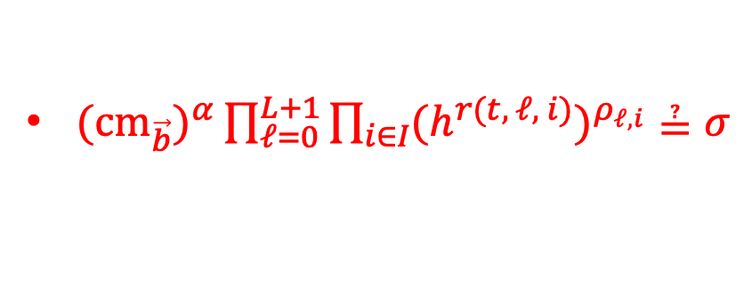
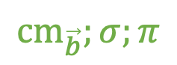
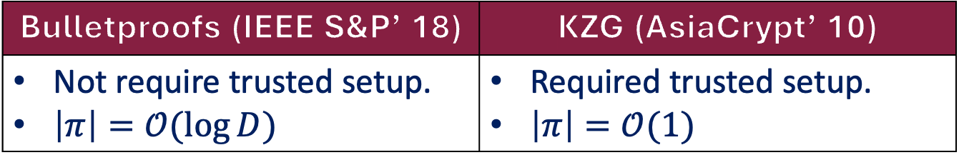
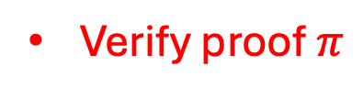
Our Audit Protocol
$α:$ secret key
Audit request + a random seed
Commitment & MAC of
aggregated codeword block
+ Proof of aggregated codeword block
Verify proof $π$
$${cm}_{\vec{b}};σ;π$$
${{(cm}_{\vec{b}})}^{α}\prod_{ℓ=0}^{L+1}{\prod_{i∈I}{{{(h}^{r(t, ℓ, i)})}^{ρ_{ℓ,i}}}}≟σ$
If $π$ is $\vec{b}$, then the total audit proof size is large if size of $\vec{b}$ is large
Bulletproofs (IEEE S&P’ 18) | KZG (AsiaCrypt’ 10)
Not require trusted setup. $\left|π\right|=𝒪(\log{D)}$ | Required trusted setup. $\left|π\right|=𝒪(1)$
Notes:
$↓↓↓$ So following the description before, the server now needs to send proof of knowledge about the aggregated codeword block.
$↓$ And the client verifies this proof to be certain that the server stores real data blocks.
$↓$ The proof can be the aggregated block itself. However, if the data block size is large, then the proof size is also large.
$↓$ So, to reduce the proof size, we harness two verifiable computation techniques.
The first one is the inner product argument in Bulletproofs, and the second one is KZG.
Bulletproofs doesn’t require trusted setup while KZG requires trusted setup.
The proof size of using Bulletproofs is BigO(log D), where D is the data block size.
And the proof size of KZG is a constant.

Slide 15



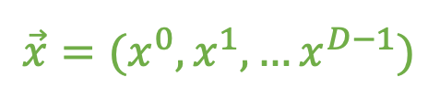
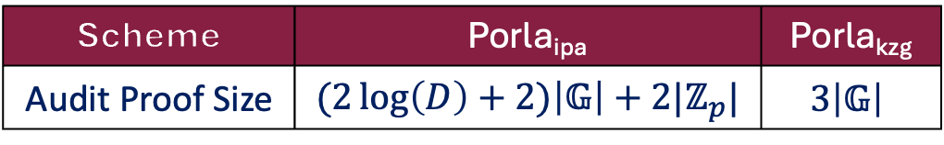
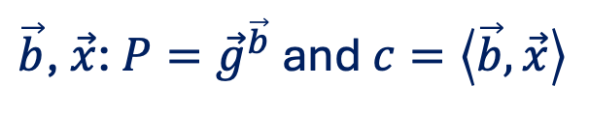




Proof of Polynomial Evaluation
Proof of the server’s knowledge of the aggregated codeword given its commitment $P$.
Scheme | Porla_{ipa} | Porla_{kzg}
Audit Proof Size | $(2\log\left(D\right)+2)\left|𝔾\right|+2|ℤ_{p}|$ | $$3\left|𝔾\right|$$
aggregated codeword
$$\vec{x}=(x^{0}, x^{1}, …x^{D−1})$$
$$\vec{x}$$
$\vec{b}$, $\vec{x}$: $P={\vec{g}}^{\vec{b}}$ and $c=\left\langle \vec{b}, \vec{x}\right\rangle$
An evaluation point
$$x$$
$$π$$
Proof
$\vec{g}∈𝔾^{D}:$independent generators
$$\vec{b}∈ℤ_{p}^{D}, c∈ℤ_{p}, P∈𝔾$$
Notes:
The idea of using verifiable computation techniques to create proof of the server’s knowledge about the aggregated codeword $↓$ given its commitment P is as follows.
We let the client send an evaluation point x to the server $↓$. Then the server uses two mentioned techniques, Bulletproofs and KZG, to create proof that it knows the aggregated codeword satisfying the given commitment P and the dot product between the aggregated codeword b and vector x, which is a power series from the value x here $↓$.
Then the server sends the proof back to the client for verification.
$↓$ And this is the size of using two schemes. Our Porla using inner product argument creates a proof of size of 2log(D) + 2 group elements and 2 values in Z_p.
And our Porla using kzg creates a proof of 3 group elements.

Slide 16
Evaluation - Configuration
Server:
Amazon EC2 c6i.8xlarge.
16-core Intel Xeon Platinum 8375C CPU @ 2.9 GHz.
64 GB RAM.
Client:
Intel i7-6820HQ CPU @ 2.7 GHz.
16 GB RAM.
Implementation:
C++ with ~4,000 LOCs.
Secp256k1 (Porla_{ipa} ), BN254 (Porla_{kzg})
Notes:
To evaluate our Porla $↓$, we use an amazon ec2 instance with 16-core Intel Xeon and 64 GB RAM.
Our client is a laptop i7 with 16 GB RAM.
Our implementation is in C++.
We use Secp256k1 library for our Porla scheme with inner-product argument and BN254 for our Porla scheme with kzg.

Slide 17
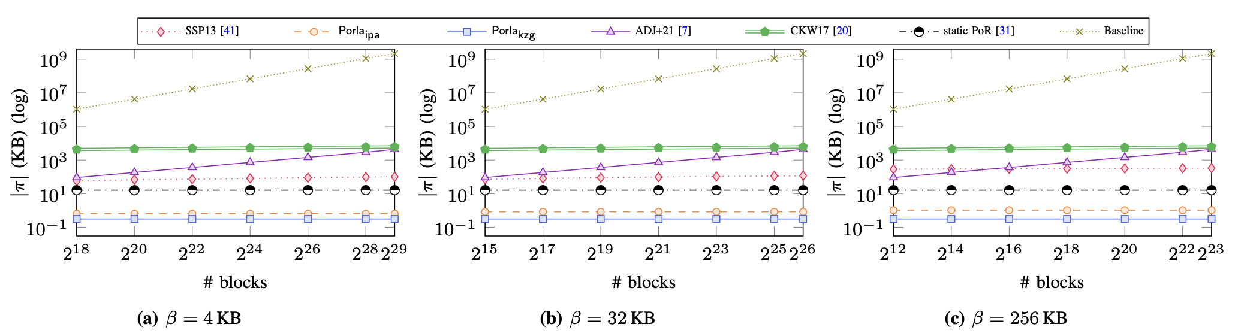
Evaluation – Audit Proof Size
$87×−14,012×$ smaller proof size than previous DPoR schemes.
Scheme | Proof Size (KB)
Porla_{ipa} | 0.64 - 1.03
Porla_{kzg} | 0.31
Independent with database size
Notes:
We perform comparisons with remarkable and state-of-the-art PoR designs $↓$.
Regarding the audit proof size of Porla, it is 87 to more than 14,000 times smaller than prior PoR schemes.
The poof size of Porla using Inner Product Argument depends on the block size. But for both our Porla schemes, the proof size is small and independent with database size.

Slide 18
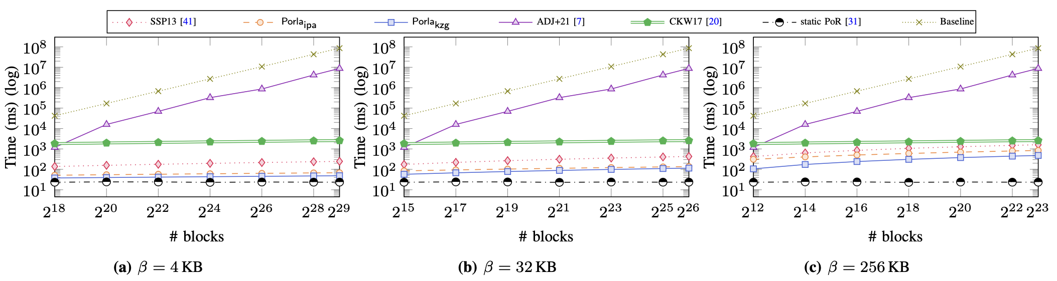
Evaluation – Audit Delay
$4×−18,000×$ faster audit time than prior approaches.
Block Size | Porla_{ipa} (ms) | Porla_{kzg} (ms)
4 KB | 51.52 – 68.04 | 37.77 – 48.66
32 KB | 84.42 – 137.44 | 57.26 – 114.98
256 KB | 310.61 – 843.84 | 105.85 – 478.68
Notes:
$↓$ About end-to-end audit latency, our Porla is 4 to 18,000 times faster than prior approaches.

Slide 19
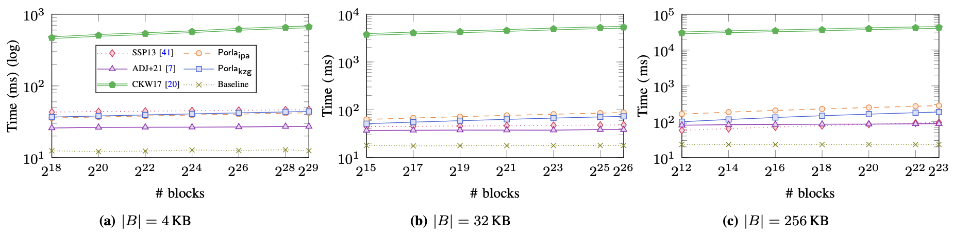
Evaluation – Update Latency
$1.2×−3×$ slower update than the counterpart using the same ECC (Shi, CCS’ 13).
Notes:
The trade-off of our scheme for smaller proof size and audit time is the longer update latency.
In comparison with the previous DPoR design by Shi in 2013 using the same erasure code, our update is 1.2 to 3 times slower.

Slide 20
Public Audit
Erasure code C:
…
Hierarchical Log H:
…
H₃
H₂
Codeword
H₁
Signature of Commitment
H₀
Verify commitments & their signatures.
Compute the aggregated commitment.
Verify the proof of server about the aggregated codeword.
Notes:
Additionally, $↓↓$ we also present how to modify the protocol to implement public audit mechanism in our paper.

Slide 21
Conclusion & Future Work
Our Porla:
Small audit cost: proof size and end-to-end latency.
Maintain a reasonable data update performance.
Our source code is available at: github.com/vt-asaplab/porla
Notes:
In conclusion, $↓$
Our Porla design is a dynamic PoR scheme that achieves small audit cost, regarding proof size and audit end-to-end latency.
In addition, it also maintains a reasonable data update performance.
$$↓$$
We publish our source code here. Please visit it for more information.

Slide 22
Thank you for your attention
Q&A
Notes:
This is the end of my presentation. Thank you for your attention. I would be happy to answer any questions.

